Slide 1



SUPERVISED ML REGRESSION CAPSTONE PROJECT - 2 ******************************** BIKE SHARING DEMAND PREDICTION ************************
https://colab.research.google.com/drive/1672qbfhFIXA4_usFpyVcgrb6A5GSaqWC?usp=sharing
https://www.kaggle.com/jaynandasana/91-7-seoul-bike-sharing-demand-prediction
https://github.com/jayu071/Seoul-Bike-Sharing-Demand_JN.git

Slide 2
Team Member
Team DATA DIGGERS
1. SARTHAK ARORA | sarthak1611@gmail.com
2. JAY NANDASANA | nandasanajay@gmail.com
3. MADHAVI MALI | madhvimali1996@gmail.com
4. PRANJALI TETE | pranjalitele@gmail.com
5. ARSHI WANI | arshiwani3@gmail.com

Slide 3
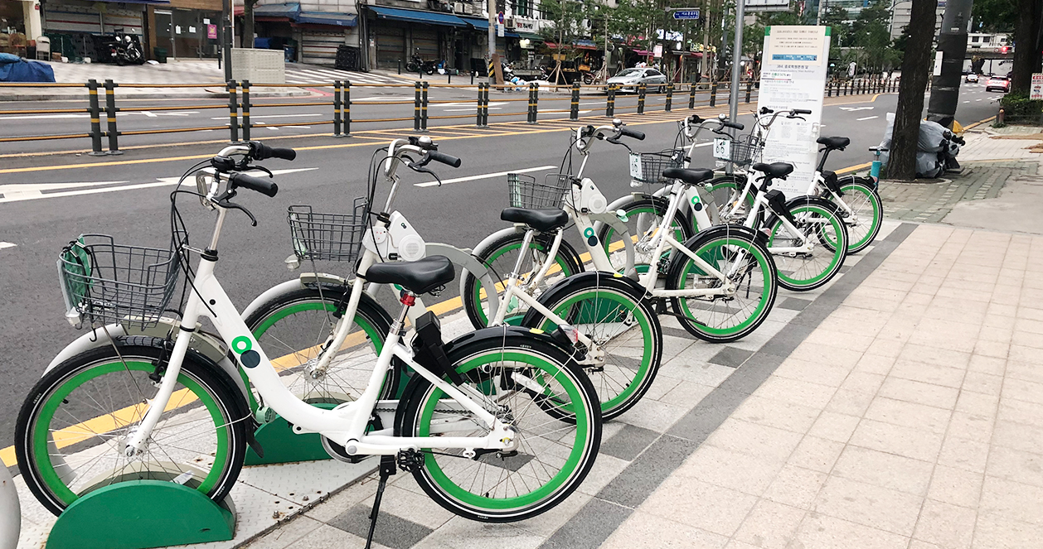
Contents
Introduction
Problem Statement
Data Analysis Steps
Attributes
Data Summary
Exploratory Data Analysis
Modeling Overview
Feature Importance
Conclusion

Slide 4
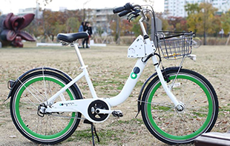
Introduction
A bike rental or bike hire business rents out motorcycles for short periods of time, Usually for a few hours. Most rentals are provided by bike shops
as a sideline to their main businesses of sales and service, but some shops specialize in rentals.
As with car rental, bicycle rental shops primarily serve people who do not have access to vehicles, typically travelers and particularly tourists.
Bike rental shops rent by the day or week as well as by the hour, and these provide an excellent opportunity for those who would like to avoid shipping their own bikes but would like to do a multi-day bike tour of a particular area.

Slide 5

Problem Statement
Currently, Rental bikes are introduced in many urban cities for the enhancement of mobility comfort. It is important to make the rental bike available and accessible to the public at the right time as it lessens the waiting time.
Eventually, providing the city with a stable supply of rental bikes becomes a major concern.
The crucial part is the prediction of the bike count required at each hour for the stable supply of rental bikes.

Slide 6
Data Analysis Steps
Imported Libraries
In this part, we imported the required libraries NumPy, Pandas, matplotlib, and seaborn, to perform Exploratory Data Analysis and for prediction, we imported the Scikit learn library.
Descriptive Statistics
In this part, we start by looking at descriptive statistic parameters for the dataset. We will use describe() function to find out mean, median and standard deviation.
Missing Value Imputation
We will now check for missing values in our dataset. after checking non existed any missing values, In case there are any missing entries, we will impute them with appropriate values.
Encoded categorical data
Since machine learning models can only be trained with numeric data ,we used OneHot encoder and Label Encoder to change categorical data into numerical data.
.

Slide 7
Data Analysis Steps
Scaling Data
We have used MinMax scalar and Standard Scale to scale our numeric data so that it becomes range bounded.
Spliting training and testing set
We split the dataset into a training and testing set. We have a randomly selected 20% subset of the data for testing. Also, we have used just the numeric and encoded columns.
Checked various models and applied hyperparamter tuning
We have used around 12 models and have applied hyperparamter tuning to get us the best accuracy with least error
Graphical Representation
We started with Univariate Analysis then bivariate Analysis and concluded with various prediction models driving the Demand for bikes

Slide 8
Attributes of each variable
Date: Date in year-month-day format
Rented Bike Count: Count of bikes rented at each hour
Hour: Hour of the Day
Temperature: Temperature in Celsius
Humidity: Humidity in %
Windspeed: Speed of wind in m/s
Visibility (10m): Visibility
Dew point temperature: Dew Point Temp (Celsius)
Solar radiation: Radiation in MJ/m2
Rainfall: Rainfall (mm)
Snowfall: Snowfall (cm)
Seasons: Winter, Spring, Summer, Autumn
Holiday: Holiday/No holiday
Functioning Day: if the day is neither weekend, holiday than 1 else 0

Slide 9
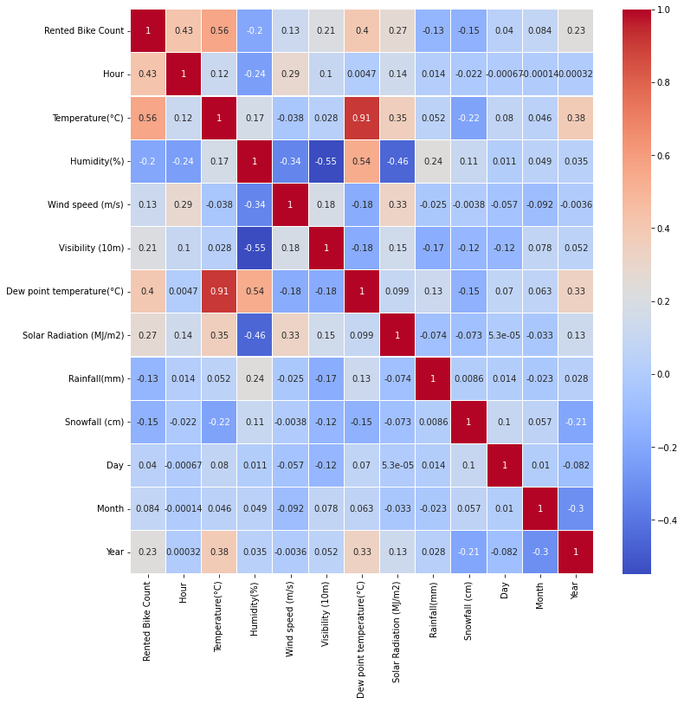
Correlation map
Heat map shows slightly positive relation of Rented bike count with Hour, Temperature, Dew point Temperature, Solar Radiation.
Bike sharing count is negatively co-related to Humidity, Snowfall, Rainfall.
Temperature and Dew point temperature are positively co-related.
Temperature and Dew point temperature are almost 0.91 correlated, So it is generating multicollinearity issue. So we drop the Dew point temperature feature

Slide 10
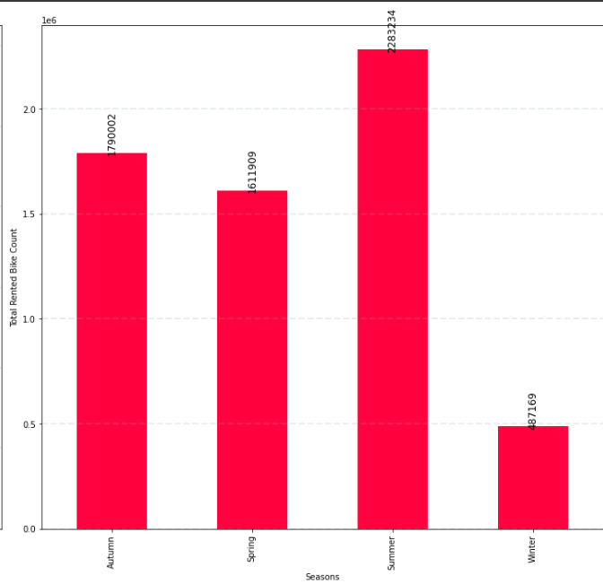
Bikes Rented Per Season
Highest number of bikes were rented in Summer. The total count of bikes rented in summer was 2.28 million
Second highest Bikes were rented in Autumn around 1.79 million followed by Spring in which 1.6 million bikes are rented.
Winter appears to be the least popular season for bike rentals. In the winter, just 487K bikes were rented.
The extreme temperatures in Seoul in the winter might be a factor in the low demand for bikes in the winter

Slide 11
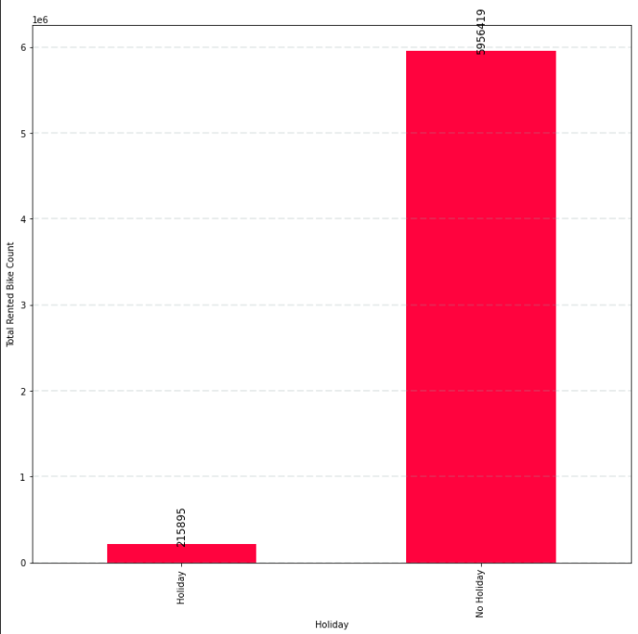
Bike Renting Trend on Holidays
People prefer to use the bike on Non-holiday more compared to Holidays.
5.9 million bikes are rented on Non-holidays, only a meager 215K bikes were rented on holidays.
It's reasonable to conclude that the majority of clients in the bike rental sector are from Seoul's working class.

Slide 12
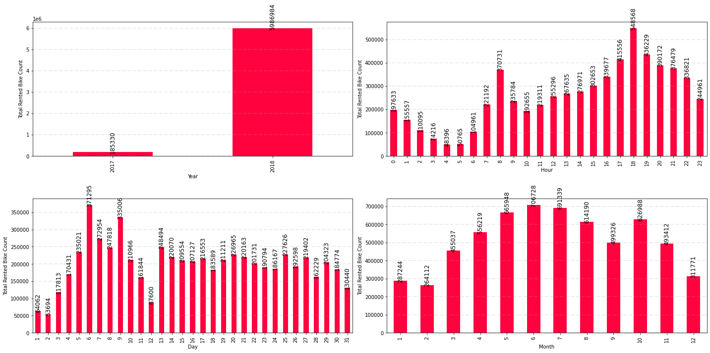
Bike Booking Monthly Trend
June is the most preferred month for bike booking around 896K bikes were rented in June.
July and May are the second and third best.734K bikes were booked in July, and 707K were booked in May.
Demand for bikes was least in Jan, followed by Feb and Dec. 150K bikes were rented in Jan, 151k in Feb, and 185K in Dec.

Slide 13
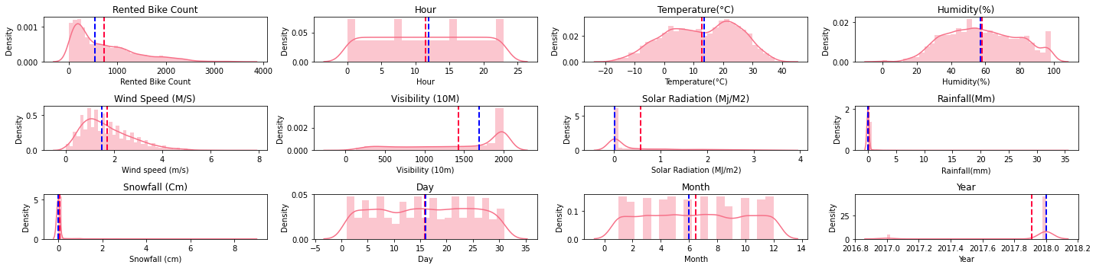
Data Distributions
Bike sharing is at its peak between 4pm- 6pm
Bike sharing is least between 4am-6am.
Most preferred temperature for bike renting is 20-30 Degree Celsius.
Bike sharing is least when temperature is < 5 and >35 Degree Celsius.
Humidity of 40%-60% is most favourable for bike sharing.
Wind speed of 1m/s -2 m/s is most favourable for bike sharing.
Bike sharing count is directly related to Visibility in the area.
Optimum Solar Radiation, no rainfall and no snowfall leads to higher bike renting in Seoul.

Slide 14
Feature Engineering on Data
Encode categorical data :
a) One-Hot Encoding
b) Label Encoding
2.Identify Inputs and Target (Independent and Dependent Variable)
Input (Ind.) = Other all Variable except “Rented Bike Count”
Output (Dep.) = Rented Bike Count
Scale values using:
a) Min-MaxScaler()
b) StandardScalar
c) RobustScaler()
Split the dataset into training and test sets.

Slide 15
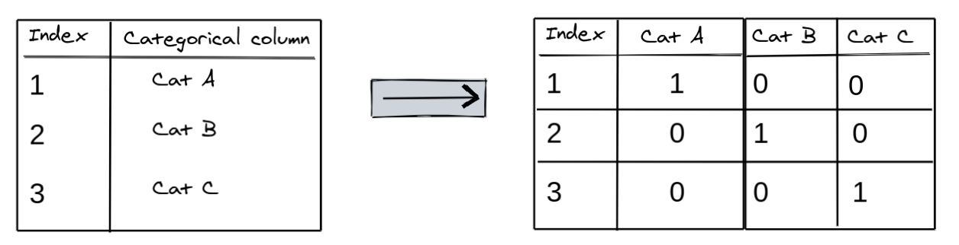
Encoding Data
Since machine learning models can only be trained with numeric data, we need to convert categorical data to numbers. A common technique is to use one-hot encoding for categorical columns. OneHot encoding involves adding a new binary (0/1) column for each unique category of a categorical column -.
OneHot encoding approach eliminates the order but it causes the number of columns to expand vastly. So for columns with more unique values try using other techniques like LabelEncoding

Slide 16
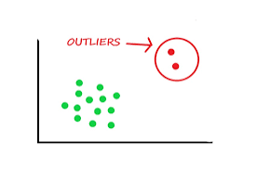
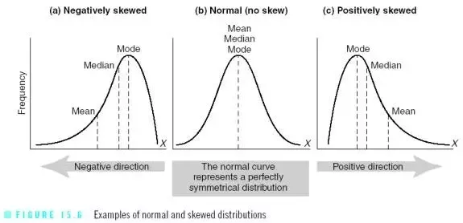
Outliers
Outliers are those data points that are significantly different from the rest of the dataset. They are often abnormal observations that skew the data distribution, and arise due to inconsistent data entry, or erroneous observations.
Outliers brings skewness in the data. Thus decreasing the accuracy sometimes. So we will deal with this problem and make our distribution normal

Slide 17
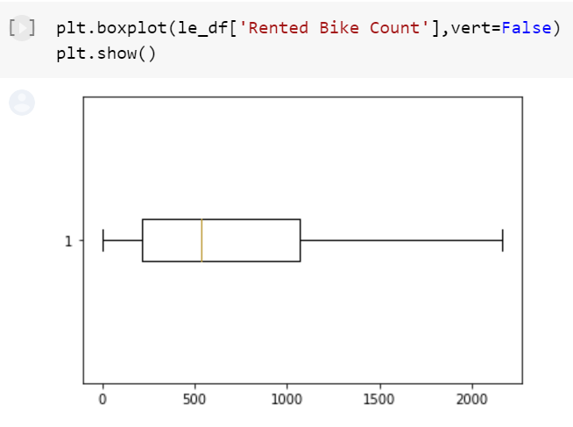
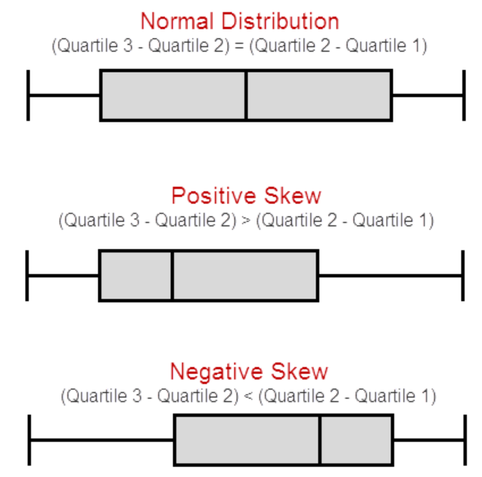
Outliers(continued)
When we plotted our boxplot we noted that it is positively skewed (you can refer the figure on the right)

Slide 18
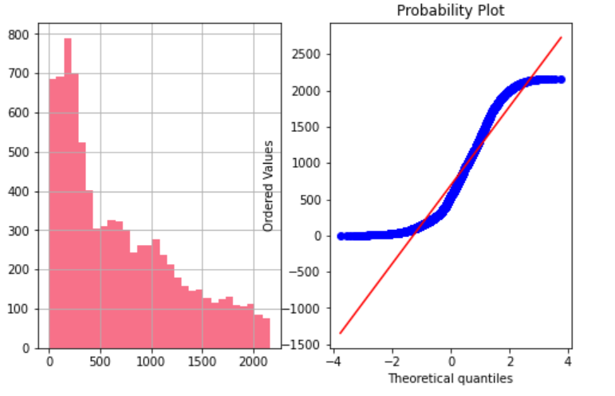
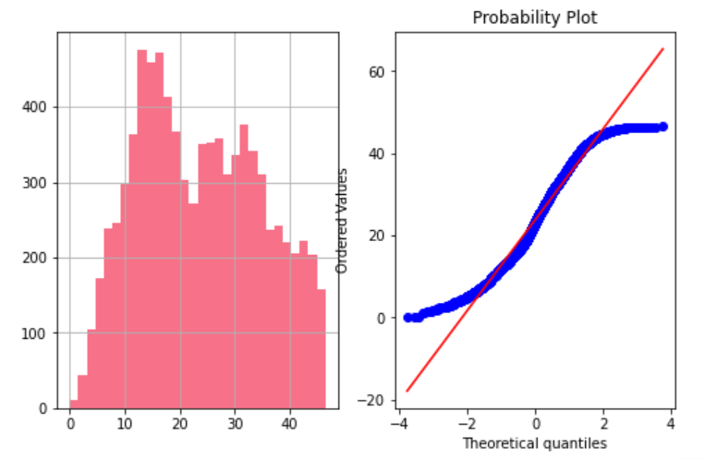
Outliers(continued)
In the following graph plots you can see positive skewed histogram and its corresponding skewed probability plot because of outliers present.
To correct the skewness we have applied square root transform . To get the normal distribution from positive skewed data.

Slide 19
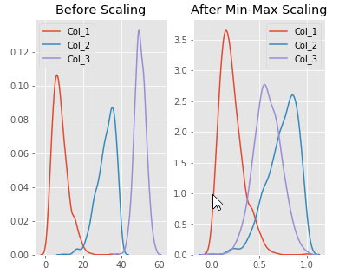
Scaling
Types of scaling :
1)MinMaxScalar- scales all the data features in the range [0, 1] or else in the range [-1, 1] if there are
negative values. It scales the values to a specific value range
Without changing the shape of the original distribution.
2)StandardScalar-In Machine Learning, StandardScaler is
used to resize the distribution of values ​​so that the mean
of the observed values ​​is 0 and the standard deviation is 1.
3)RobustScalar-This Scaler removes the median and scales the data according to the quantile range (defaults to IQR: Interquartile Range).

Slide 20
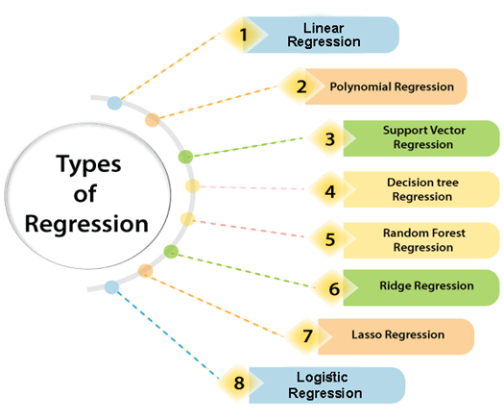
Scaling Data and Model Building
We checked the accuracy of our model using different scaling methods & different Regression’s also.
We apply all 3 different scaler and check accuracy difference between scalers.
Checking difference between Actual test value and Predicted value

Slide 21
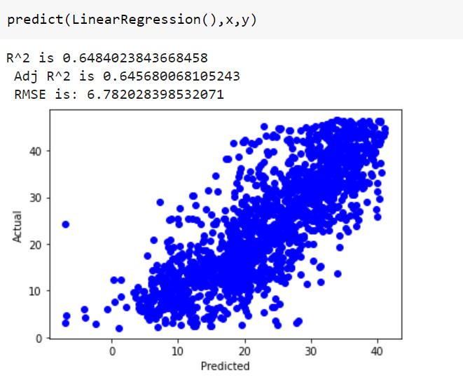
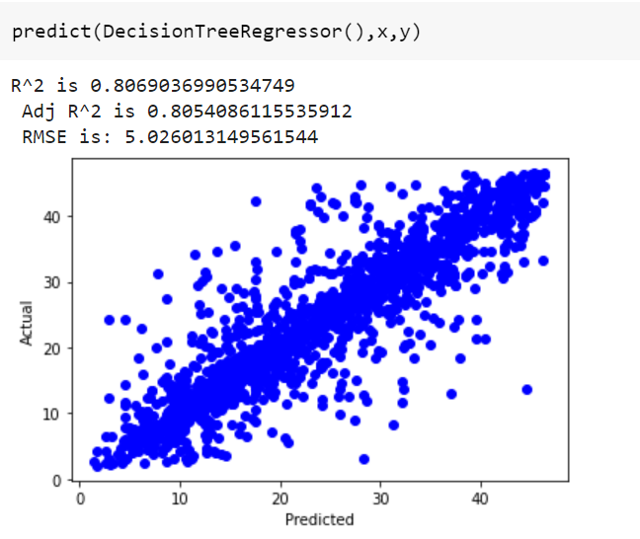
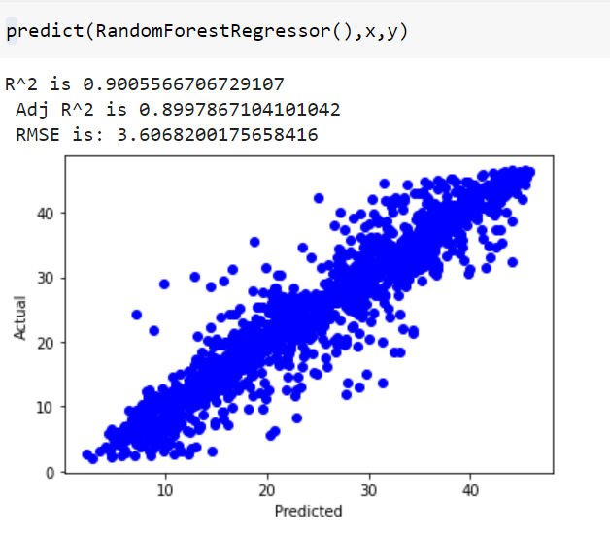
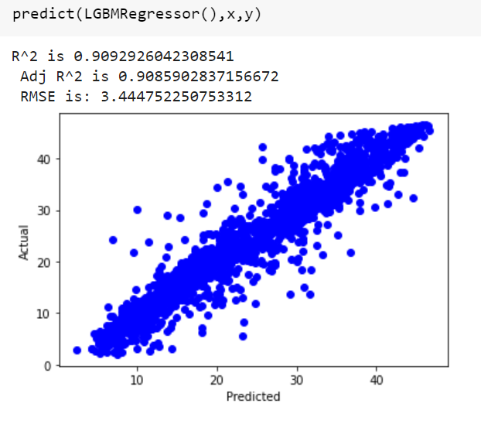
Using RobustScaler

Slide 22
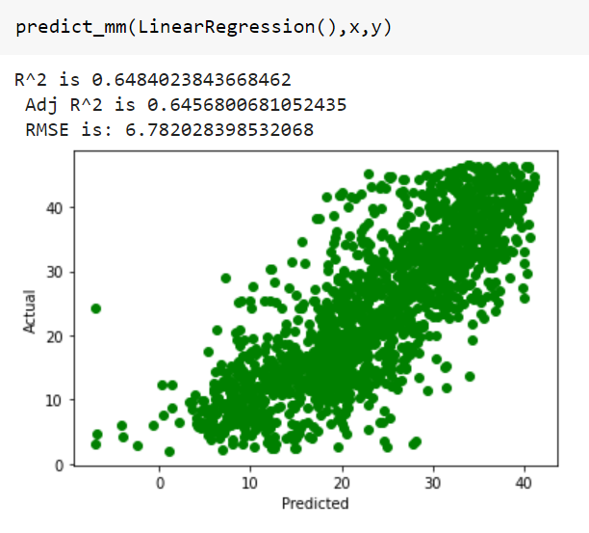
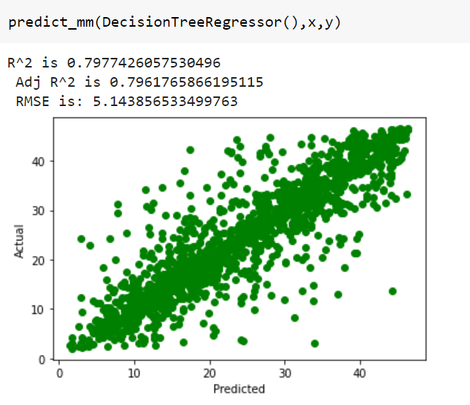
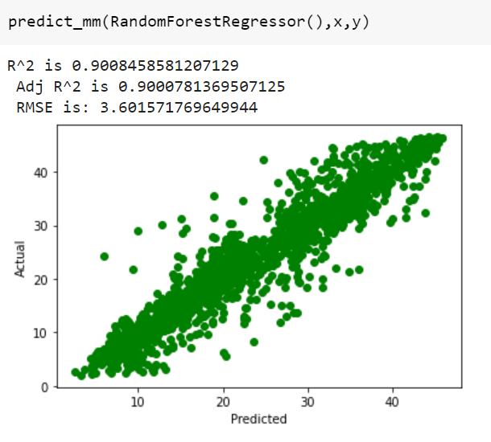
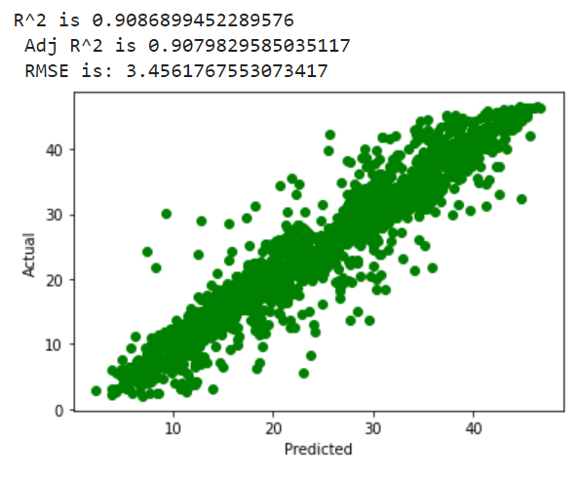
Using MinMaxcaler

Slide 23
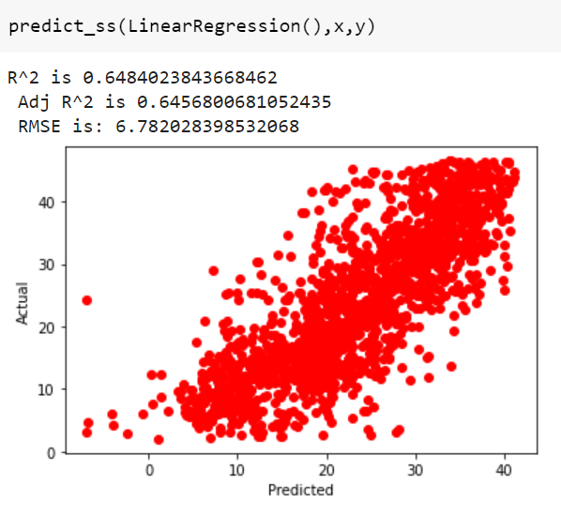
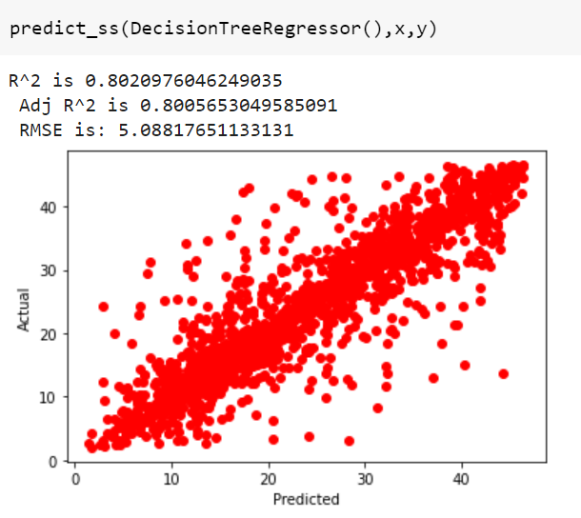
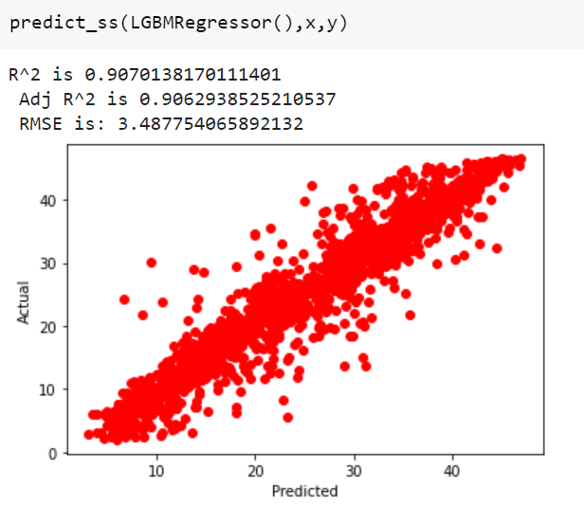
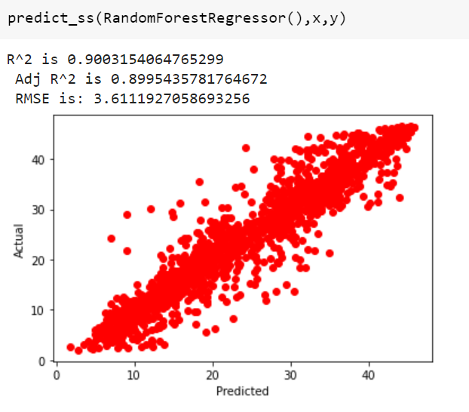
Using StandardScaler

Slide 24
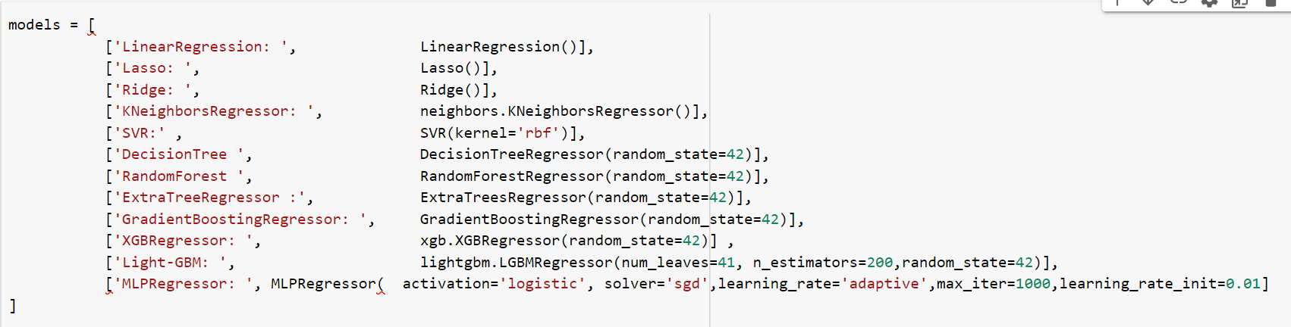
Models List
In this project we used total twelve models, so that we can compare the final Root mean square error and R2 score of this models.

Slide 25
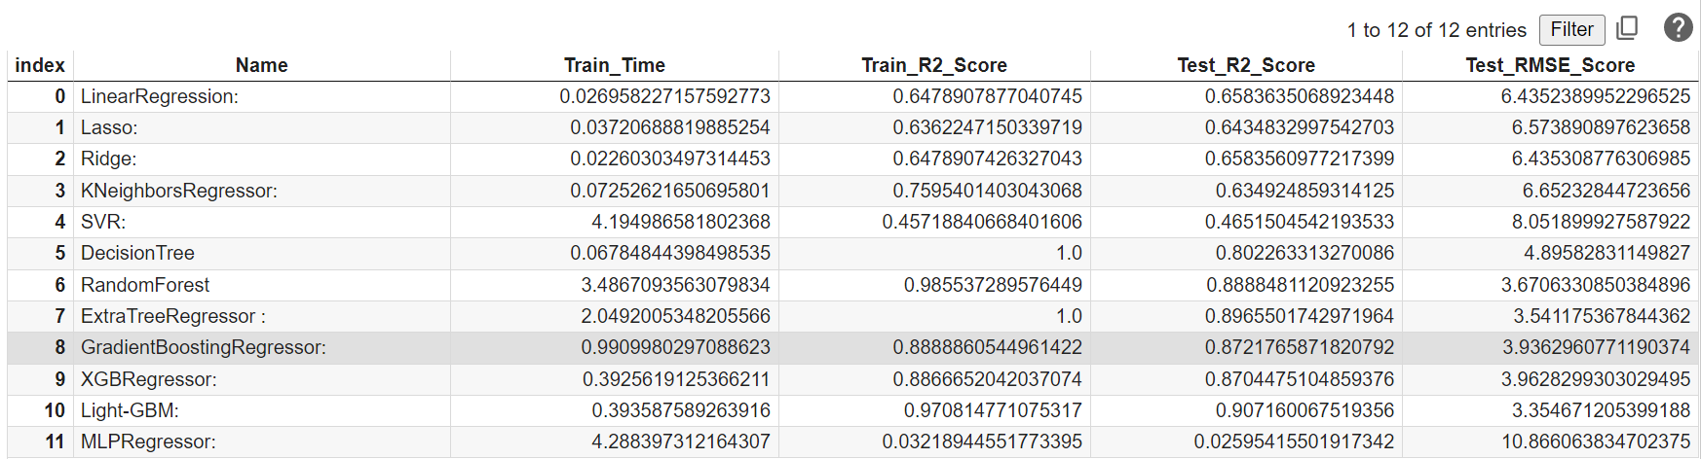
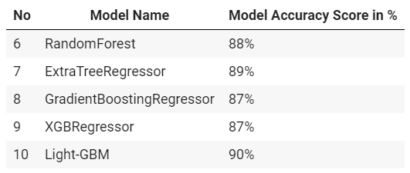
Models Accuracy and Results
As per above results
Train_R2 and Test_R2 Score being near to 1 is considered as a good model.
Lightgbm, ExtraTreeRegressor and RandomForestRegressor give us max R2
score and least Root mean square error on test set.
So, In above results best models are

Slide 26
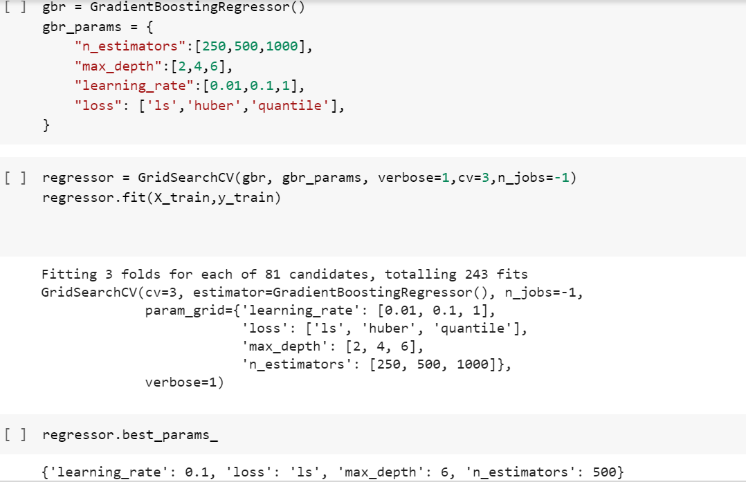
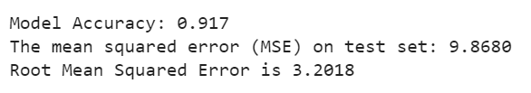
Hyperparameter Tuning of GradientBoostingRegressor
In hyperparameter tuning we have chosen the important hyperparater such as learning_rate, max_depth, and the n_estimators. The max_depth and n_estimators are the same parameters that we chose in a random forest. Here we are taking an extra that is the learning_rate.
We call the Boosting Regressor Constructor and define the parameters.
Here we have applied all relevant possible values for each the hyperparamter
After Hyperparameter tuning, the accuracy of the model went from 87% to 91.7%

Slide 27
Conclusions
Most numbers of Bikes were rented in Summer, followed by Autumn, Spring, and Winter. May-July is the peak Bike renting Season, and Dec-Feb is the least preferred month for bike renting.
Majority of the client in the bike rental sector belongs to the Working class. This is evident from EDA analysis where bike demand is more on weekdays, working days in Seoul.
Temperature of 20-30 Degrees, evening time 4 pm- 8 pm, Humidity between 40%-60% are the most favorable parameters where the Bike demand is at its peak.
Temperature, Hour of the day, Solar radiation, and Humidity are major driving factors for the Bike rent demand.
Feature and Labels had a weak linear relationship, hence the prediction from the linear model was very low. Best predictions are obtained with GradientBoostingRegressor with applied hyperparamter tuning with r2 score of 0.917 and RMSE of 3.2018

Slide 28
THANK YOU

